Slide 1





Web Fundamentals Project

Slide 2
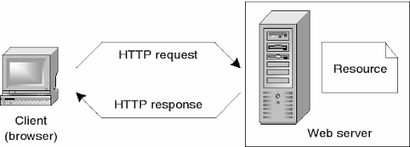
1. How does the web work ?
The web browser connects to the web server and sends an HTTP request for the desired web page.
The web server receives the request and checks for the desired page.
If the page exists, the web server sends it.
If the server cannot find the requested page, it will send an HTTP 404 error message.

Slide 3



2. What do you need to be a web developer?
To become a Web Developer,:
You should have an understanding of HTML, CSS, and JavaScript.
Also Key skills to be successful in web development include:
Computer literacy
Strong numeracy skills
Strong creative ability
Attention to detail

Slide 4
Strong communication skills
Excellent problem-solving skills
A logical approach to work
The ability to explain technical matters clearly
A keen interest in technology Ongoing self-learning is key to developing in a web development role, in order to stay up to date with ever more frequent technological advancements and updates

Slide 5
2. What is the role of a web developer ?
Web developers are responsible for programming the code that 'tells' a website how to function.
They build websites that are 'user friendly', which means they are easy to navigate for those using them.
They also build functions within a website

Slide 6

Thank You

